Slide 1

Unlocking The Ideal Seattle Home: Your Key to Lively and Central Living
Maren Bormann

Slide 2

Your wishes
Nicole Johnson, buyer
Characteristics:
Lively, central neighborhood
Middle price range
Right timing (within a year)

Slide 3

The dataset
Database with information on home sales in King County (USA) (2014 until 2015)
Notes:
Some missing values, I only needed variables without missing values
I had to change the variable date
Duplicate values 177, need to consider if that influences further analysis

Slide 4
Finding your ideal home
1. House prices are higher in lively and central neighborhoods compared to less lively neighborhoods.
2. Houses in central areas have a higher average 'grade' and 'condition' score compared houses in less central locations.
3. The best time to buy a house within a year is winter, due lower competition and prices.

Slide 5
Hyphothesis 1
House prices are higher in lively and central neighborhoods compared to less lively neighborhoods.

Slide 6
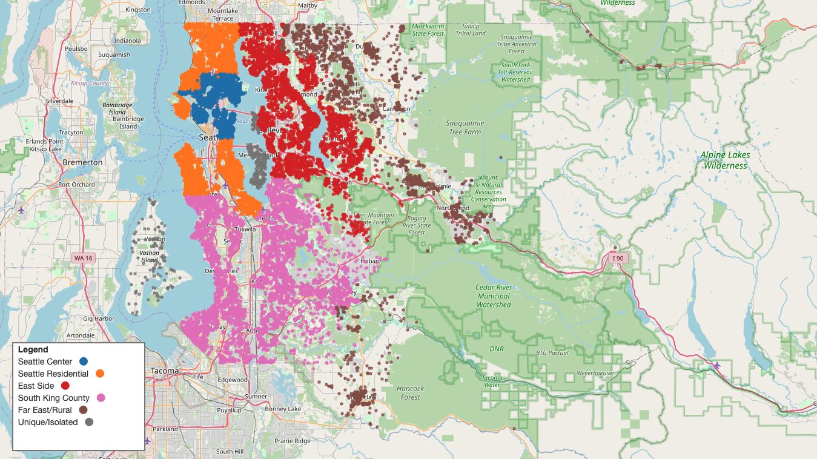
Open in browser

Slide 7
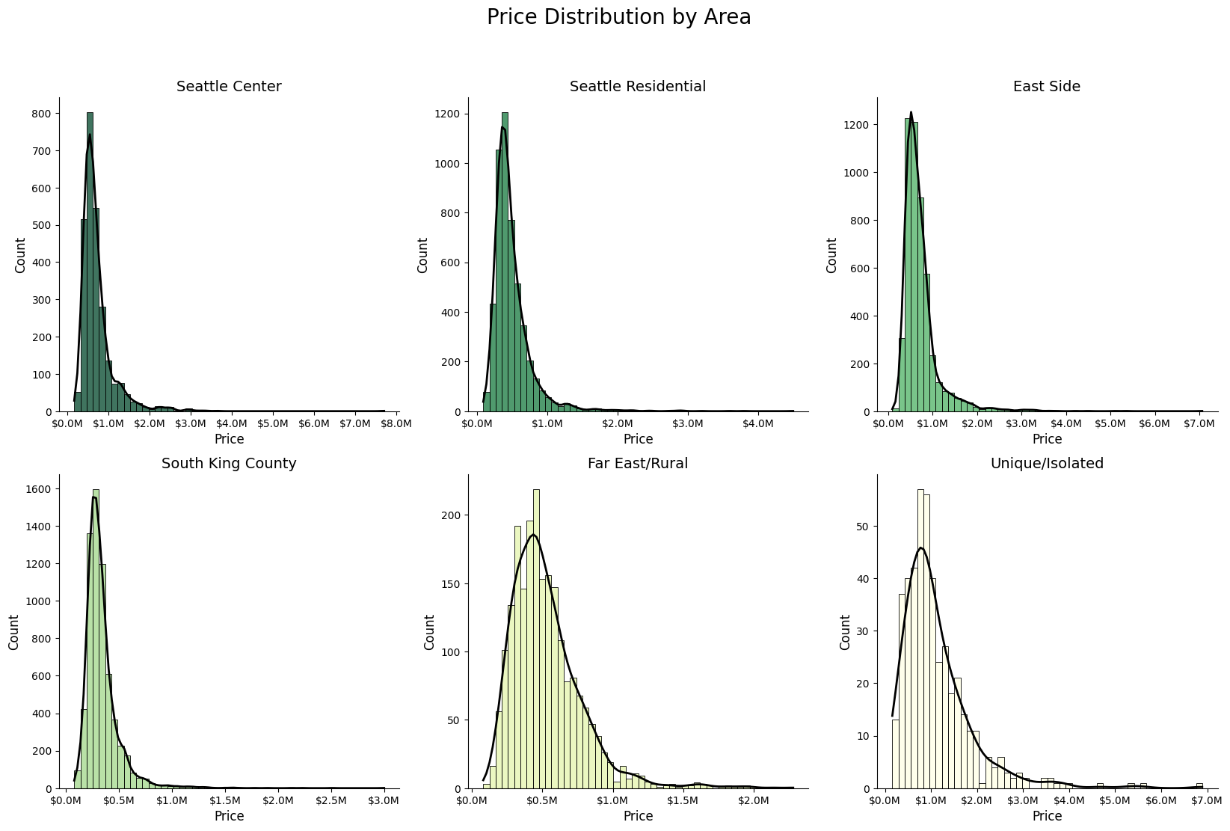
Expensive homes elevate average housing prices
Notes:
Price distribution by area

Slide 8
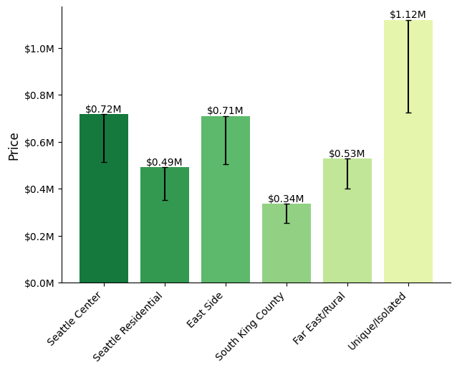
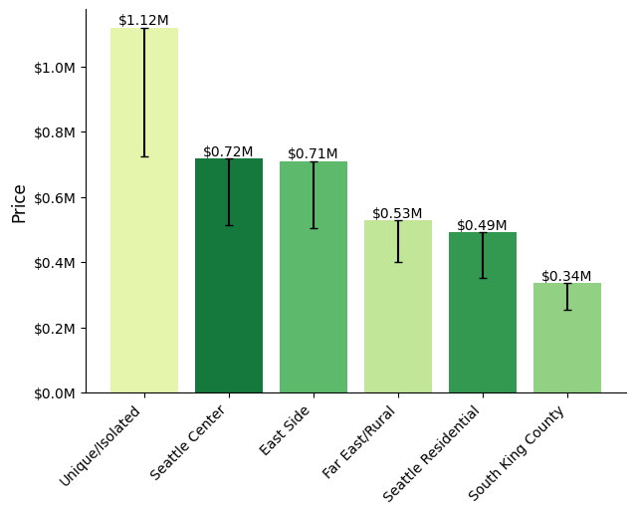
Average house prices by area – defined by centrality
Houses in residential area offer balanced combination of affordability and central location
Notes:
Middle price range: 50% of all houses in price range $0.32 - $0.45 USD

Slide 9
Hyphothesis 1
House prices are higher in lively and central neighborhoods compared to less lively neighborhoods.
Centrality has an impact on the price, however, isolated and wealthy areas are even more expensive

Slide 10
Hyphothesis 2
Houses in central areas have a higher average 'grade' and 'condition' score compared houses in less central locations.
Notes:
Condition: coded from 1-5 with higher number indicate better condition, based on design/quality of construction and if repairs are needed
Grade: grading system goes from 1-13, with higher numbers better quality. Based on if it meets building standards, workmanship, materials, architectural design

Slide 11
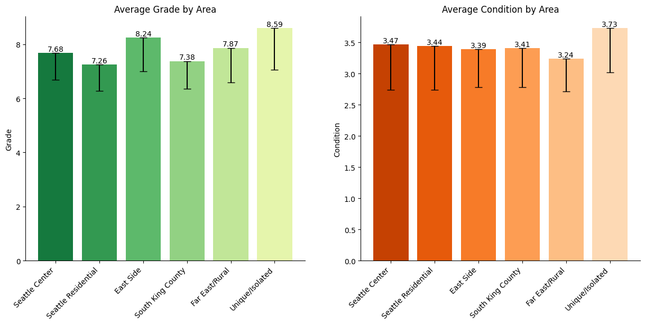
Average house grade and condition score by area – defined by centrality
Houses in expensive area have highest average grade and condition score
Average scores overall very similar in different areas
Notes:
Condition: coded from 1-5 with higher number indicate better condition, based on design/quality of construction and if repairs are needed
Grade: grading system goes from 1-13, with higher numbers better quality. Based on if it meets building standards, workmanship, materials, architectural design

Slide 12
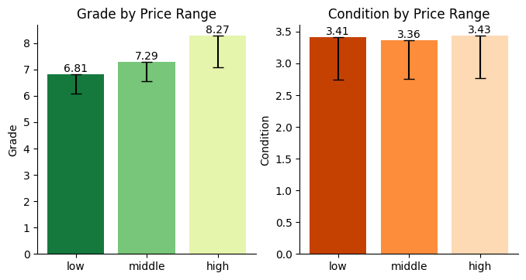
Average house grade and condition by price range
Middle priced houses have grade in the mid-range
Notes:
Mostly interested in middle priced houses, divided houses by their price range

Slide 13
Hyphothesis 2
Houses in central areas have a higher average 'grade' and 'condition' score compared houses in less central locations.
Scores were overall very similar, but wealthy and isolated areas have highest grade
Notes:
Condition: coded from 1-5 with higher number indicate better condition, based on design/quality of construction and if repairs are needed
Grade: grading system goes from 1-13, with higher numbers better quality. Based on if it meets building standards, workmanship, materials, architectural design

Slide 14
Hyphothesis 3
The best time to buy a house within a year is winter, due lower competition and prices.

Slide 15
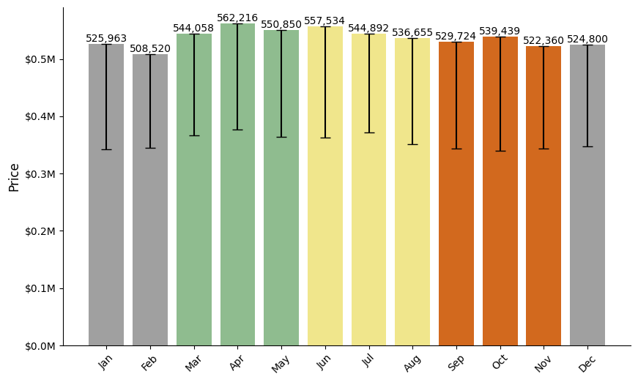
Average house price by selling month
Houses are cheaper in winter months

Slide 16
Hyphothesis 3
The best time to buy a house within a year is winter, due lower competition and prices.

Slide 17

RecommendationS
Houses in residential area are close to downtown of Seattle, have lively spots as well and are cheaper than in the center!
Grade and condition scores of houses are similar in different areas; houses in wealthy and isolated areas have a higher grade
Middle-priced houses receive grades in the mid-range of the grading scale.
The best time to buy a house within a year is winter!
Notes:
Future work: now only worked with the zip codes, Analyze the impact of distance to central areas on price more precisely by calculating distance of the houses based on their location

Slide 18
The dataset
Database with information on home sales in King County (USA)
Overall good quality of the data, but:
Some missing values
Change of variable types
Duplicate values (177)
Notes:
I only needed variables without missing values
I had to change the variable date
Duplicate values, need to consider if that influences further analysis

Slide 19

How?
Cleaning of the data
Sorted ZIP codes into different areas, based how lively and central
Calculated prices by area
Calculated grade and condition by area
Impact of price range on grade and condition
Impact of selling month on price

